Slide 1
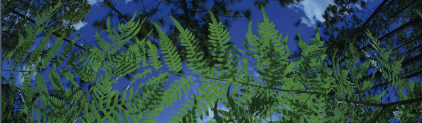



Using Digitized Specimen Data in Research: Applications for Ecology, Phylogenetics, and Biogeography
Pam Soltis
University of Florida
BiotaPhy

Slide 2
Topics
Intro to data
Downloading data
Cleaning data
Georeferencing
GEOLocate
Ecological Niche Modeling
Maxent
ENM Analysis & Interpretation
Scaling Up – BiotaPhy
Additional uses of collections data
Discussion/Q&A
Manual and R-based options

Slide 3

Workshop Leaders
Pam Soltis
Makenzie Mabry
Lauren Gillett
Shelly Gaynor
JT Miller
Elizabeth White
Maria Cortez
Doug Soltis
Malu Ore Rengifo
Contributions from many previous lab members/colleagues:
Blaine Marchant, Charlotte Germain-Aubrey, Andre Naranjo, Anthony Melton, Tal Kinser, Mike Belitz, Rhett Rautsaw, João Vidal, Jr.
BiotaPhy

Slide 4
Logistics
Dropbox folder
https://www.dropbox.com/sh/gtvo3z20rw5j7wt/AADKEhCHgHxxM9gjT8MPq8c4a?dl=0
Word doc with schedule and instructions
Presentations folder
Demos folder
Workshop evaluation survey
by email
Pace/breaks

Slide 5
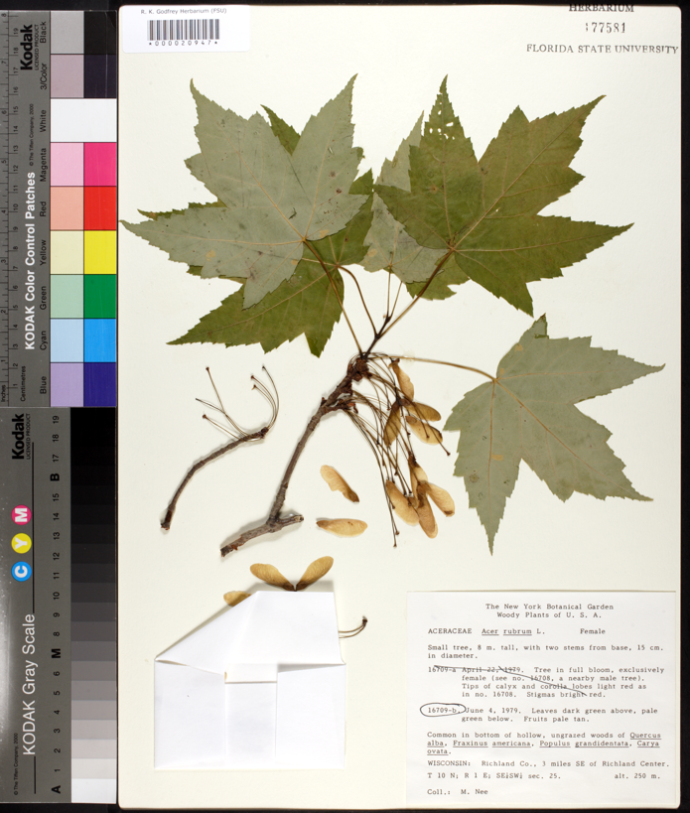
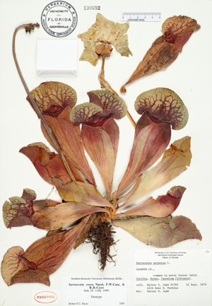
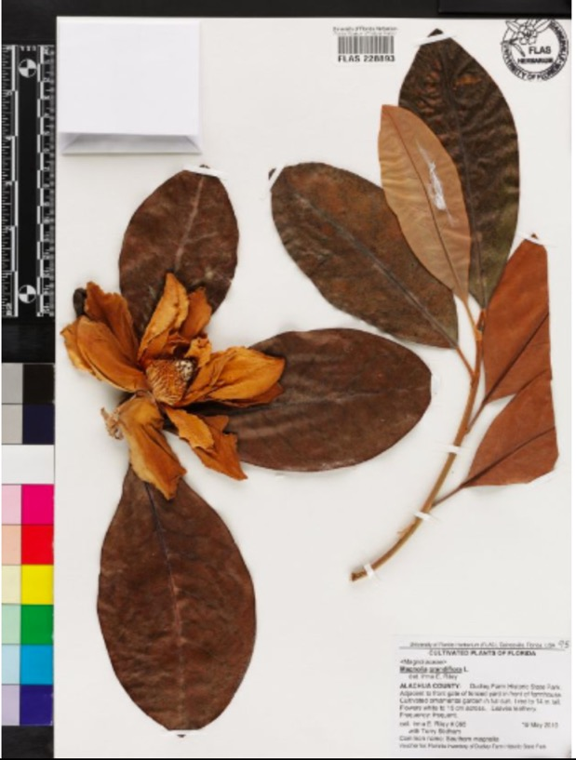
Notes:
As botanists, we’re probably all familiar with herbarium specimens. Here we see specimens of a magnolia, a maple, and a pitcher plant.
Herbarium specimens have been collected for centuries.

Slide 6
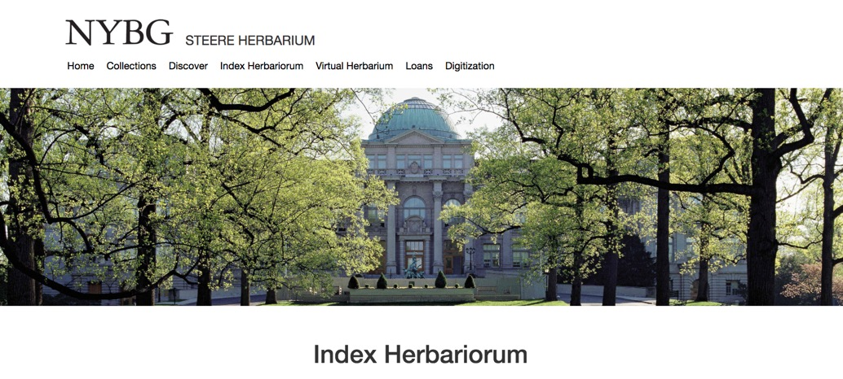
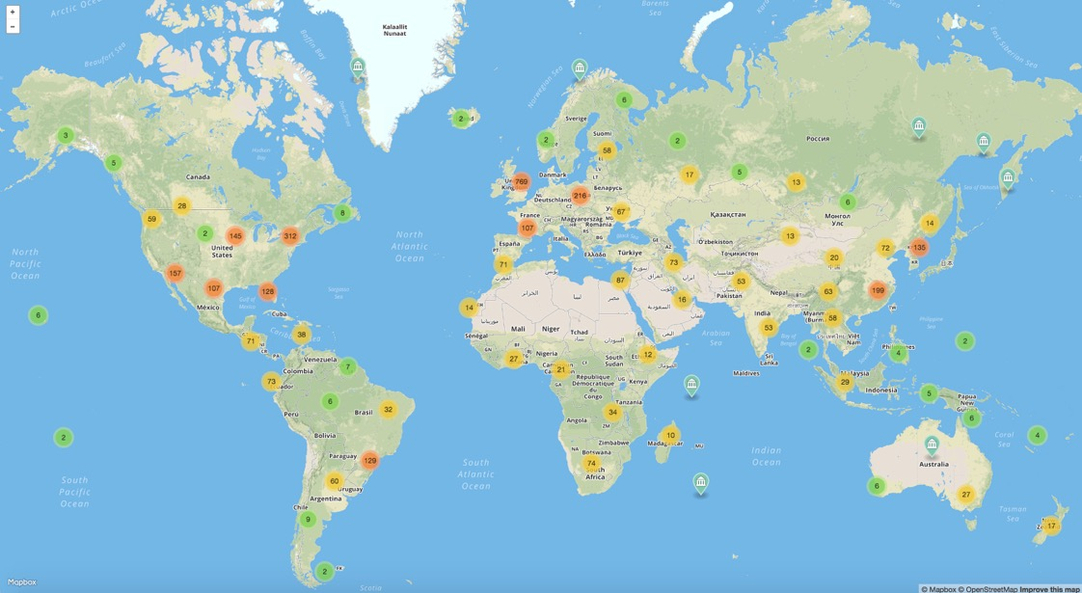
Herbaria Worldwide
3,400 herbaria
400,000,000 specimens!
Notes:
Globally, there are ~3400 herbaria, and they contain an estimated 400,000,000 specimens!
Every one of the world’s herbarium specimens has a story to tell, and what’s more, each specimen is packed with data that can be used in a broad range of scientific studies.

Slide 7
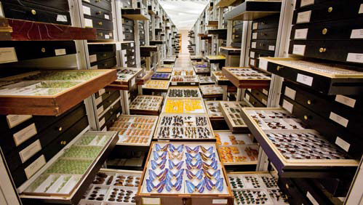
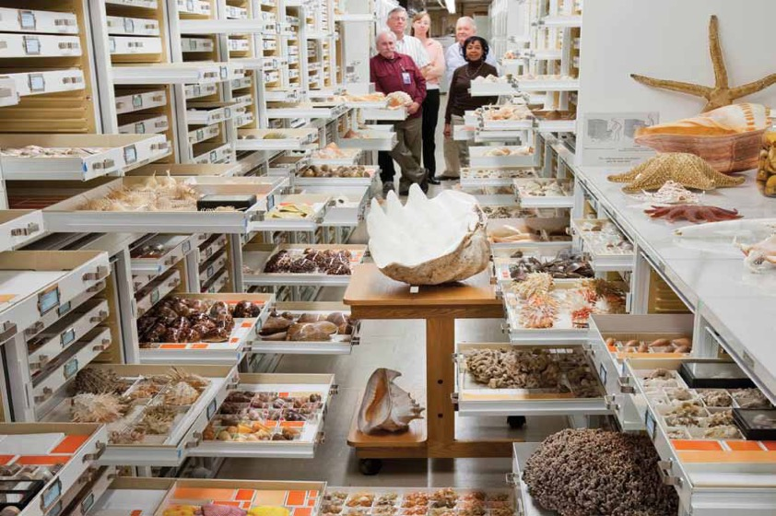
Natural History Collections
~1600 natural history collections in the US, thousands in the world
1-2 billion specimens
in the US
3-4 billion specimens worldwide
Smithsonian
Notes:
Let’s step back from herbaria specifically and consider natural history collections more broadly. ...

Slide 8
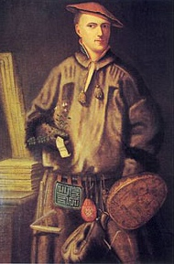
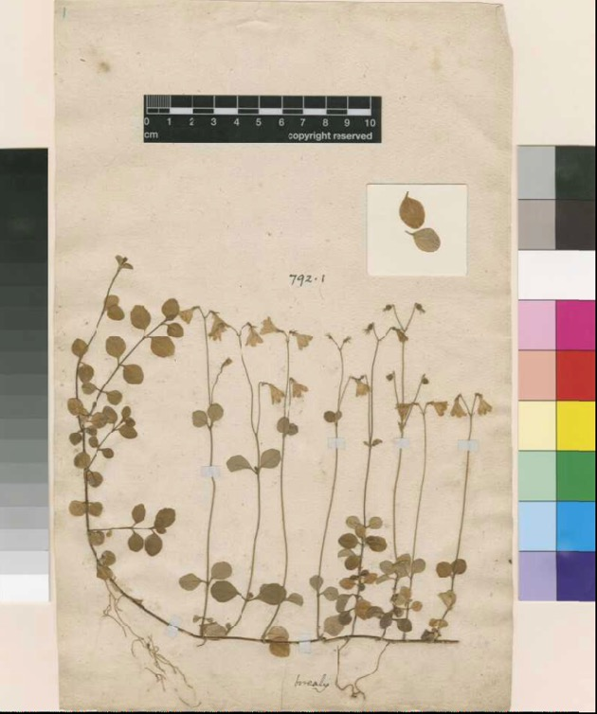


Systematics & Taxonomy
Linnaea borealis, 1732
Carl Linné, aka Carolus Linnaeus
Notes:
Most specimens were originally collected as a way of documenting the biota of a particular region. For most of their history, museum specimens have formed the basis of systematics and taxonomy, as they still do today. most of what we know about the living world comes from nat hist collections.

Slide 9
Uses of Natural History Collections
Genetics
Genomics
Chemistry…
…Species interactions
Phenology
Biogeography
More!
Smithsonian
Notes:
but today, the uses extend beyond the traditional fields of taxonomy and systematics and include...

Slide 10
Uses of Natural History Collections
Most specimens locked
away in cabinets, unavailable for general use.
Smithsonian
Notes:
however, ...

Slide 11
Uses of Natural History Collections
DIGITIZATION
Smithsonian
Notes:
Digitization is changing that, and is bringing specimens out of the cabinets and onto computer screens worldwide.

Slide 12
Digitization: Data and Images
Scientific name –
including authority
Date
Collector
Location – state, county,
specific site,
GPS coordinates
Associated species
Notes
Notes:
What do we mean by digitization? it refers to both data and images. Each herbarium specimen, although a pressed plant or part of a plant, carries important additional information in its label. Ideally, the label, which is typically located in the lower right corner of the specimen, will contain the scientific name of the plant, the date it was collected, the name of the collector, the location of the collection – in the US, this would include the state, county, specific description, and for recent collections GPS coordinates, any associated species that co-occurred with the plant, other notes – maybe the slope, aspect, and so on – the more, the better! As you can imagine, a detailed record can provide abundant data. Today, this information is being databased so that there are electronic records associated with our specimens.

Slide 13
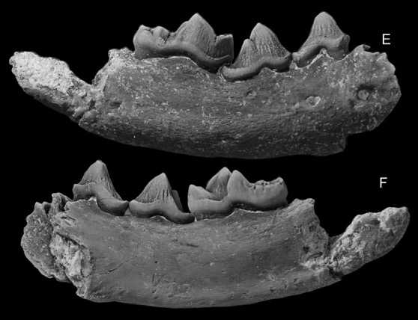
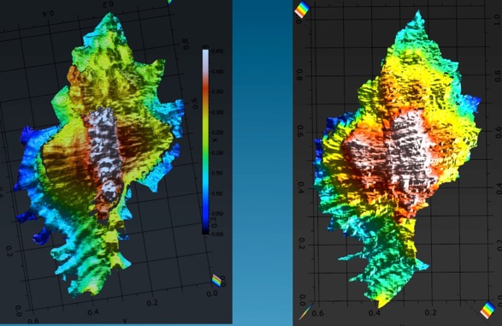
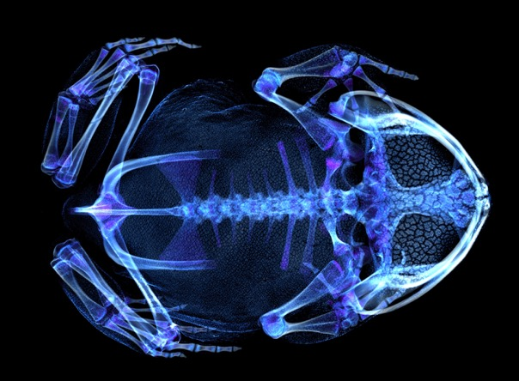
Digitization: Data and Images
Notes:
in addition, images of various types are providing access to the specimens while also revealing new aspects of the specimens themselves.

Slide 14


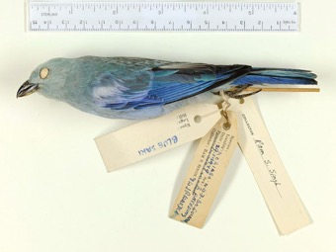
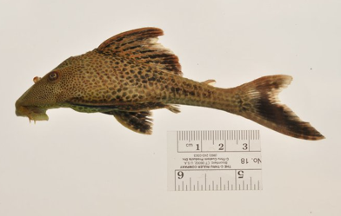
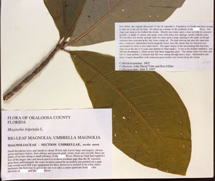
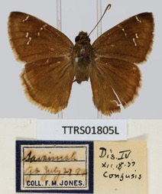
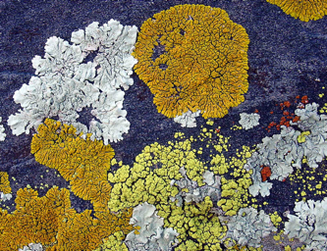
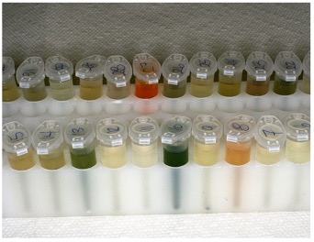
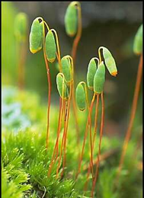
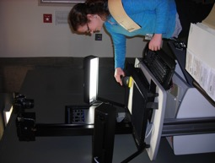
iDigBio: www.idigbio.org
National Coordinating Center
For Digitization of Biodiversity Collections
Ingest, serve, integrate data:
Localities
Dates
Images
Notes:
Harnessing these data—the goal of idigbio. Collab between arch rivals UF FSU

Slide 15
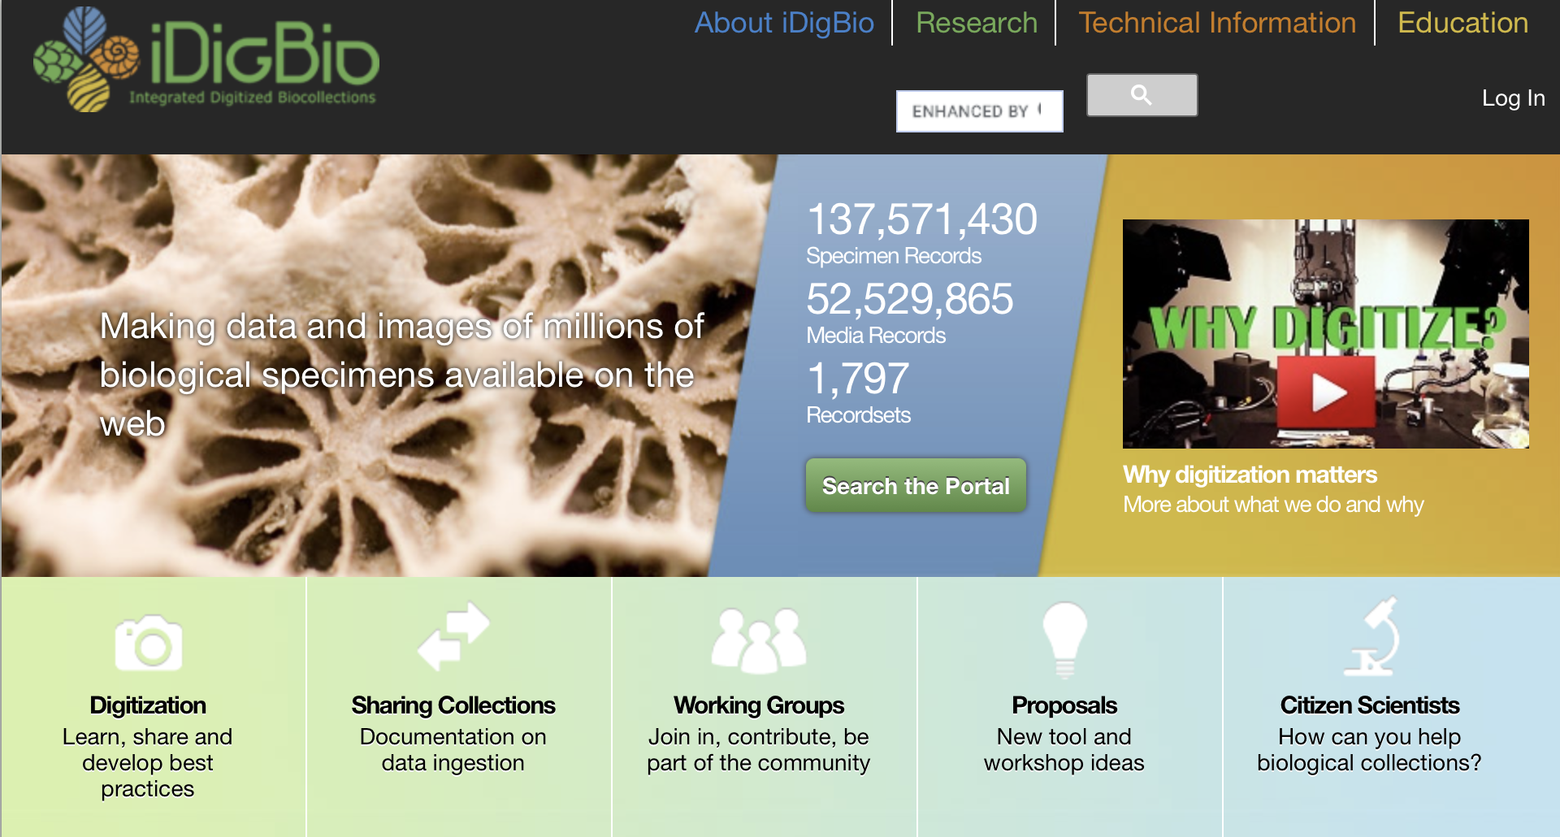
iDigBio: A Source for Specimen Records
www.idigbio.org

Slide 16
Specimen Occurrences in iDigBio
www.idigbio.org
Notes:
If you go to the iDigBio website – idigbio.org – you’ll see a map that shows the density of specimen coverage – specimens cover most of the globe.

Slide 17
Label Data from Herbarium Specimens
Scientific name –
including authority
Date
Collector
Location – state, county,
specific site,
GPS coordinates
Associated species
Notes

Slide 18
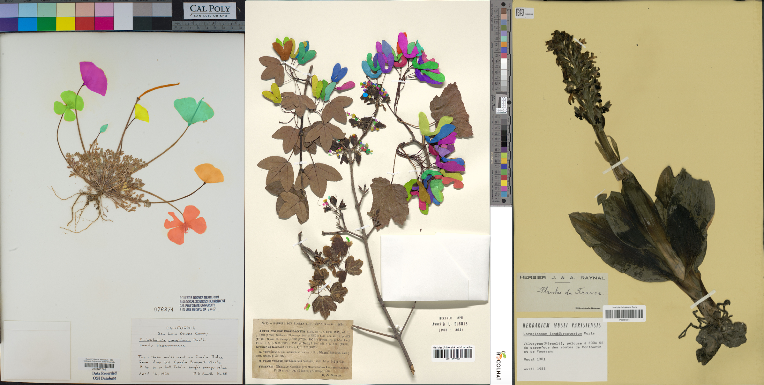
Machine Learning & Biodiversity Research
Pearson et al. 2020
Carranza-Rojas et al. 2017

Slide 19
Machine Learning & Plant Biology:
Special Issue of APPS (2020)
June: Herbarium Specimen Images
Phenology (2)
Morphology
Herbivory
Species Identification (2)
Software: Leaf Detection
Software: Leaf Recognition and Measurement
Edited by P. Soltis, G. Nelson, A. Zare, E. Meineke
Notes:
If you’re interested in learning more about the use of machine learning in plant biology, please see a special double issue of Applications in Plant Sciences from 2020. The June issue has 8 articles on the use of herbarium specimen images, and the July issue has 8 articles on other applications.

Slide 20
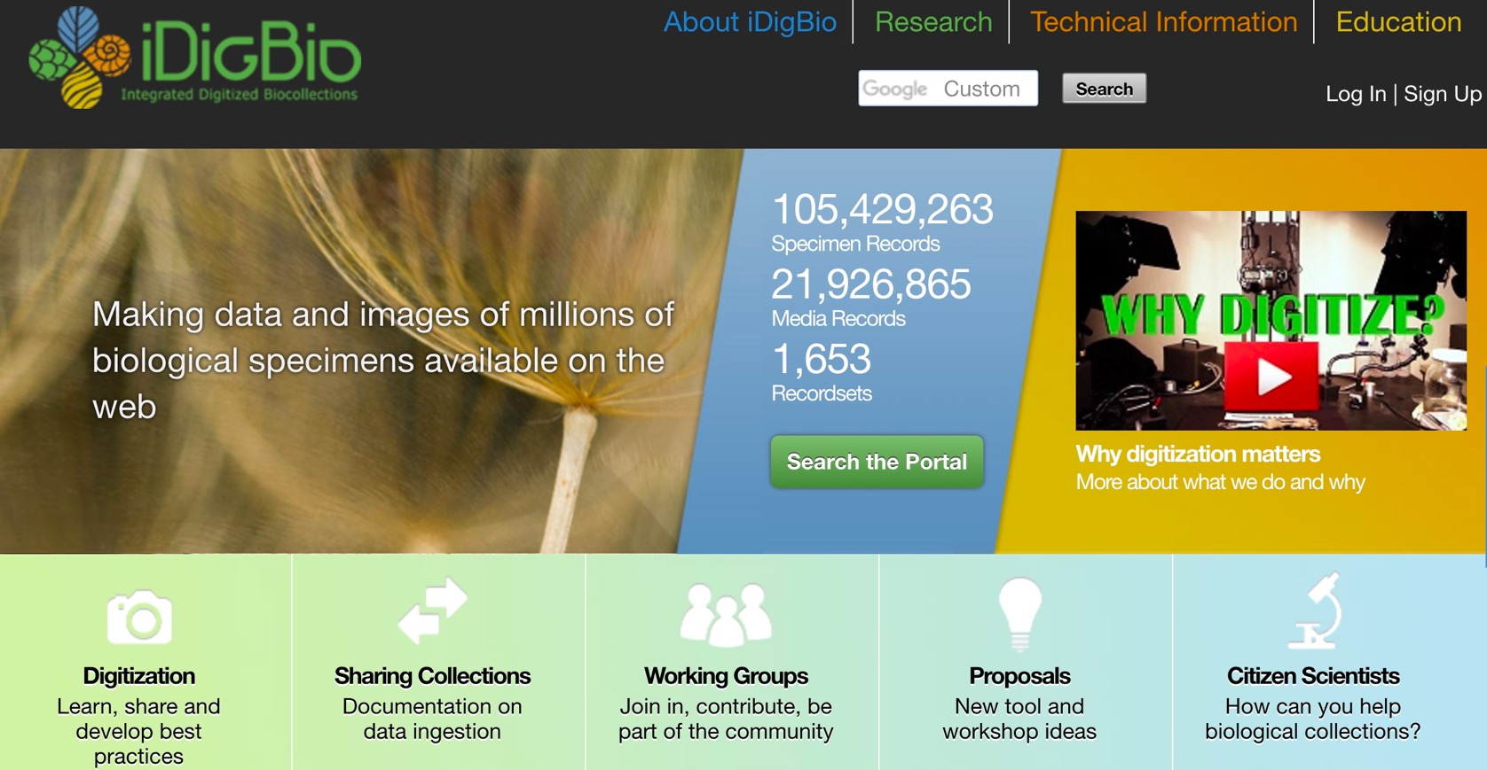

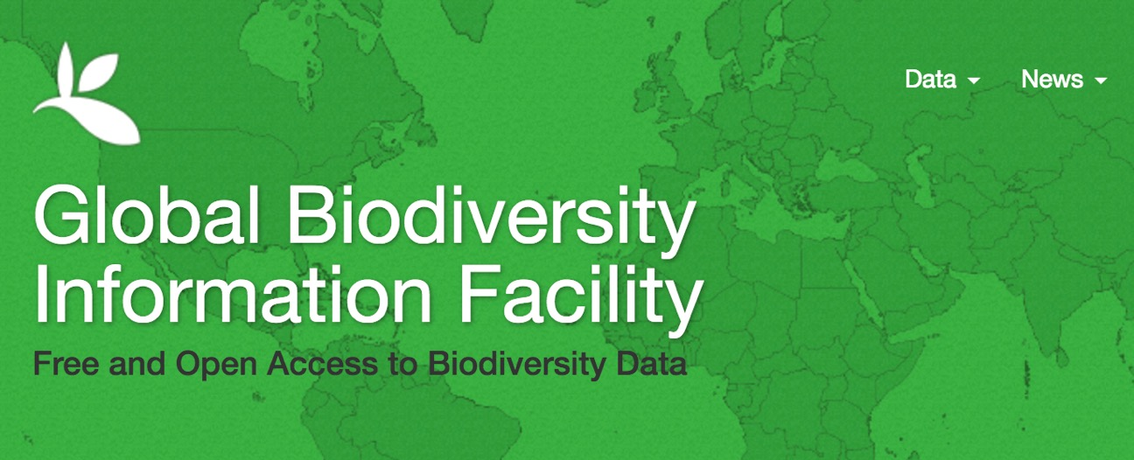



Other Data Aggregators
Notes:
iDB is referred to as a specimen data aggregator – and there are other specimen data aggregators, such as those shown here, so that there is a global network of specimen data.

Slide 21
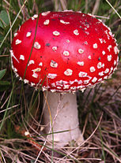
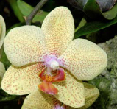
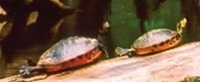
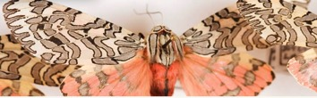
‘Big Data’ Research in Biodiversity Science
Monitoring shifts in biodiversity
Tracking invasive species
Ecological Niche Modeling, climate change
Past movements and climate change
Tracking phenological shifts
Landscape genetics
Integration of ENM with phylogeny
Community phylogenetics/assembly
Biogeography

Slide 22
Overview of Day’s Activities
8:00 Welcome and Overview of the Workshop – Pam
8:15 Darwin Core and Data Fields – Pam
8:30 Data Downloading Overview – Makenzie
9:00 Activity: Manual Data Downloads, iDigBio Portal – Lauren
9:30 Activity: R-based Data Downloads – Shelly
9:45 Data Cleaning Overview – JT
10:00 Break
10:30 Activity: Data Cleaning (A) Manual (JT)
(B) R-based (Shelly)
11:00 Georeferencing Overview – Lauren
11:15 Activity: Georeferencing (A) Manual (Lauren)
(B) R-based (Makenzie)
Notes:
Here is our outline of activities

Slide 23
Overview of Day’s Activities
12:15 Lunch
1:00 Climatic Processing Overview – Shelly
1:20 Activity: Climatic Processing – (A) Manual (Elizabeth)
(B) R-based (Shelly)
2:00 Ecological Niche Overview – Makenzie
2:15 ENM Settings Overview – JT
2:30 Activity: Ecological Niche Modeling (A) Manual (Elizabeth)
(B) R-based (Shelly)
3:00 Break
3:30 Interpreting ENMs Overview – Shelly
3:40 Activity: Interpreting ENMs (A) Manual (Elizabeth/Lauren/Makenzie)
(B) R-based (Shelly)
4:00 Post-ENM analysis – Shelly
4:15 BiotaPhy: An Overview – Doug/Maria
4:30 Wrap-up and Q&A
5:00 End
Notes:
Here is our outline of activities

